Slide 1
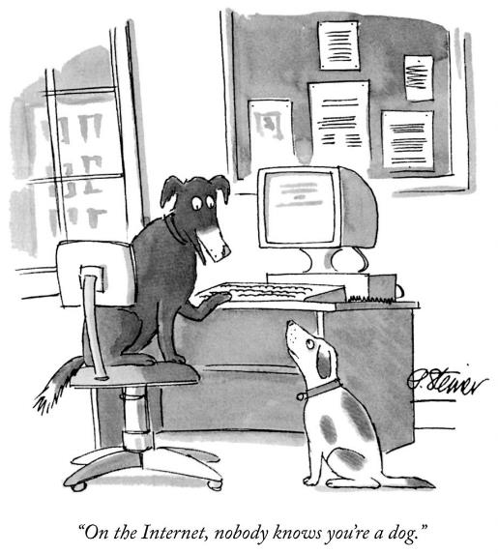
Prof Sam Chan
COMM3131 Online Dating and Hookup Culture
Meeting 2 |
Getting it on online:
How special is computer-mediated communication?
Notes:
Image originally from The New Yorker
https://www.acxiom.com/wp-content/uploads/2014/04/on-the-internet-nobody-knows-921x1024.jpg

Slide 2
Today
Computer-mediated communication
Selected theories of CMC
Getting to know each other
Theorizing online dating
Basic statistical understandings (optional)

Slide 3
Computer-mediated communication
Any form of communication between two or more persons via separate computers through a network
“lo” – the first message sent through ARPANET
Early CMC tools: Email + bulletin board systems
How can we show that we are joking just through texts?
:-)
:-(

Slide 4

Computer-mediated communication
CMC include different methods by which two computers communication:
  Emails
  BBS/forums
  Short text messages
  Emojis
  Audio call
  Video call
  VR

Slide 5
Social identity model of deindividuation effect (SIDE)
Cues are signals: verbal and non-verbal
Earlier ideas:
Fewer cues (70s’)→ less warmth and less involved (idea rejected)
Lack of social context cues hypothesis (80s’): why people are so nasty online?
Notes:
Walther, J. B. (2011). Theories of computer-mediated communication and interpersonal relations. In M. L. Knapp & J. A. Daly (Eds.), The handbook of interpersonal communication (4th ed., pp. 443–479). Sage.

Slide 6
Social identity model of deindividuation effect (SIDE)
SIDE (Lea & Spears, 1992)
That is, although partners who communicate romantically online may believe that they love each other interpersonally, this would be an illusion
Visual anonymity in CMC → deindividuation + social-based interactions
Social identification → in-group dynamics or out-group dynamics
Notes:
Walther, J. B. (2011). Theories of computer-mediated communication and interpersonal relations. In M. L. Knapp & J. A. Daly (Eds.), The handbook of interpersonal communication (4th ed., pp. 443–479). Sage.

Slide 7

Social information processing
  Joseph Walther (1992)
  CMC users are motivated to develop impression → users make use of whatever cues available
  CMC requires longer time because the lack of cues slows down the rate of information transmission (this part rejected)
Notes:
Walther, J. B. (2011). Theories of computer-mediated communication and interpersonal relations. In M. L. Knapp & J. A. Daly (Eds.), The handbook of interpersonal communication (4th ed., pp. 443–479). Sage.

Slide 8
Hyperpersonal communication
Joseph Walther (1996)
How can CMC facilitate impressions and relationships online that exceed the desirability and intimacy that occur in parallel off-line interactions?
Effects due to receiver processes
Effects among message senders
Attributes of the channel, and
Feedback effects
Notes:
Walther, J. B. (2011). Theories of computer-mediated communication and interpersonal relations. In M. L. Knapp & J. A. Daly (Eds.), The handbook of interpersonal communication (4th ed., pp. 443–479). Sage.

Slide 9
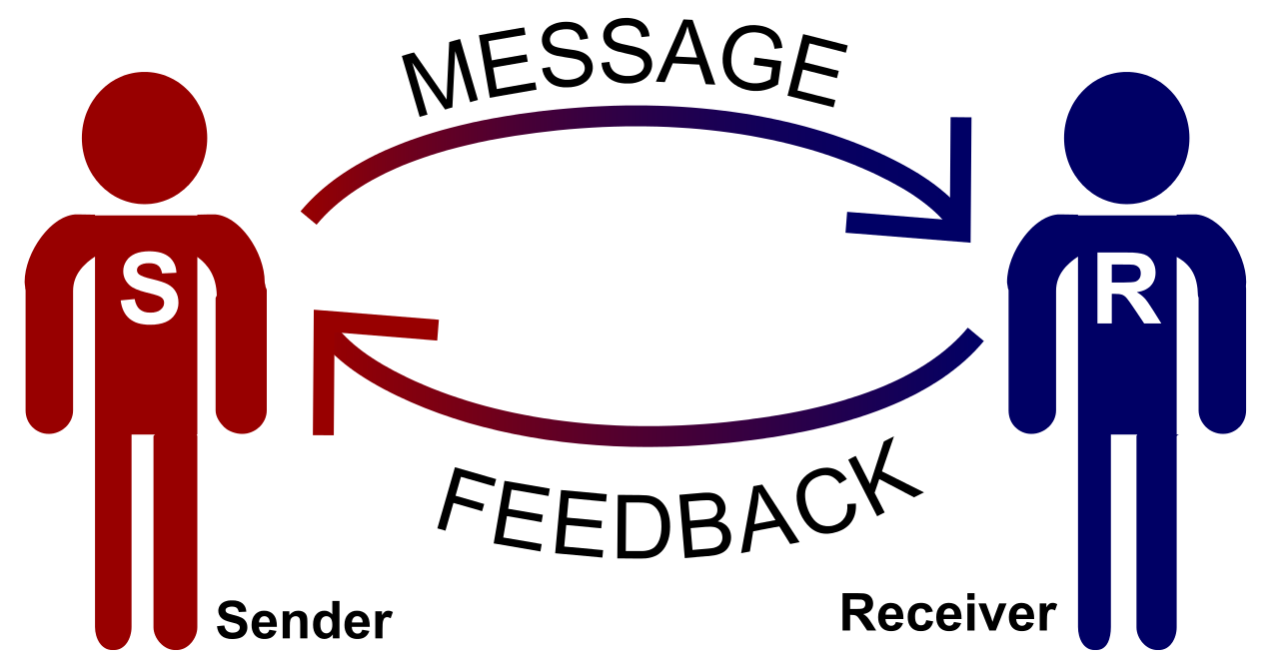

Slide 10
Warranting
A concept developed by Joseph Walther and Malcolm Parks (2002)
Some information are “immune to manipulation by the person to whom it refers” (p. 552) → such information is considered trustworthy
Checking system-generated data and third parties’ comments
Notes:
Walther, J. B. (2011). Theories of computer-mediated communication and interpersonal relations. In M. L. Knapp & J. A. Daly (Eds.), The handbook of interpersonal communication (4th ed., pp. 443–479). Sage.

Slide 11
Getting to know each other

Slide 12
What is online dating? How does it work? How does it look like? What is at stake?

Slide 13
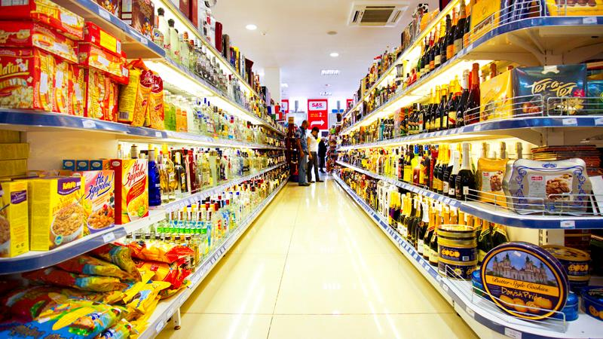
Theories of online dating I:
Market metaphor
“Marriage market” (cf. 1973) or “dating market”
How do online daters understand this market metaphor?
Assessing others’ market worth
Assessing one’s own market worth
Shopping for the perfect parts
Adjusting the level of selectivity
Resisting
Notes:
Heino, R. D., Ellison, N. B., & Gibbs, J. L. (2010). Relationshopping: Investigating the market metaphor in online dating. Journal of Social and Personal Relationships, 27(4), 427–447. https://doi.org/10.1177/0265407510361614

Slide 14
From relationshipping to relationshopping
Notes:
Heino, R. D., Ellison, N. B., & Gibbs, J. L. (2010). Relationshopping: Investigating the market metaphor in online dating. Journal of Social and Personal Relationships, 27(4), 427–447. https://doi.org/10.1177/0265407510361614

Slide 15

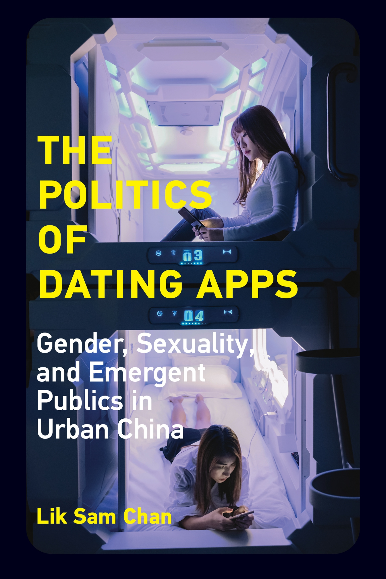
Theories of online dating II:
Networked sexual publics
Publics: a collection of people
Sexual publics: see themselves as part of a shared experience of sexuality (cf. Katherine Sender)
Networked publics: growing engagement with digital media (cf. Mizuko Ito)

Slide 16
Theories of online dating II:
Networked sexual publics
Both the people and the space
  People: shared positionality and connected by dating apps
  Space: multiple interpretations and relationships
Highlight the political dimension
  Women and men negotiate their power
  Sexual minorities strive for a place in the heteronormative world

Slide 17
Basic statistical understandings
(optional)

Slide 18
Basic statistical understandings
Most statistics evaluate if there is a relationship between two variables
Most statistics results are represented by a number that ranges from - ∞ to ∞
  If the number is positive, then the relationship between a variable A and a variable B is positively correlated
  If the number is negative, then the relationship between a variable A and a variable B is negative correlated

Slide 19
 | Negative | Positive
No relationship | 0 | 0
Statistical results | -∞ | ∞

Slide 20
Basic statistical understandings
Results may, however, happen by chance
So, we have p-value (significance value), ranging from 0 to 1
The smaller the p-value, the less likely the results happen by chance
We want p-values to be smaller than 0.05
When the p-value is smaller than 0.05, we use the symbol * to indicate
Sometimes, you will see ** or *** → these are good!

Slide 21
 | Negative | Positive
No relationship | 0 | 0
Statistical results | -∞ | ∞
 | p-value smaller than
* | 0.05
** | 0.01
*** | 0.001

Slide 22
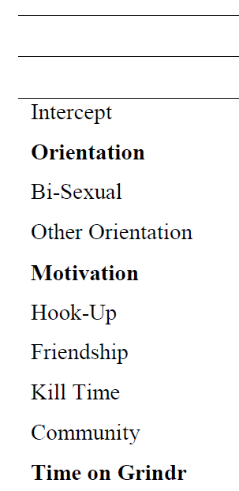
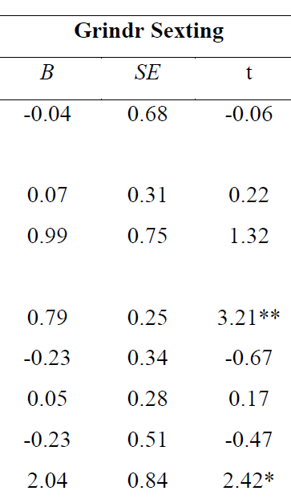
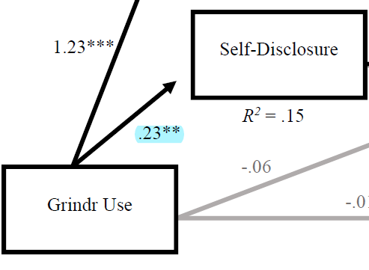
ignore

Slide 23
Next week
Lecture | “Still up?”: Communicating about yourself and your desire
Self-disclosure: Dimensions, benefits, risks
Dramaturgical view of self-presentation
Case studies: Self-presentation and self-disclosure of gay men in the US and China
Deviation of information (deception as one kind)

